Slide 1
Domain-Driven Design Workshop
February 19, 2020

Slide 2
Introductions
Overview & History
Section 1 (9:15 - 10:30)
Ubiquitous Language
Section 2 (10:45 - 12:30)
Strategic Design
Lunch (12:30 - 1:30)
Section 3 (1:30 - 3:30)
Tactical Design
Section 4 (3:45 - 5:30)
Layered Architecture
Wrap-up (5:30 - End)
Today’s Agenda
Notes:
Remove “Confidential and Proprietary…” on this and subsequent footers?

Slide 3
Introductions

Slide 4







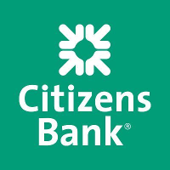
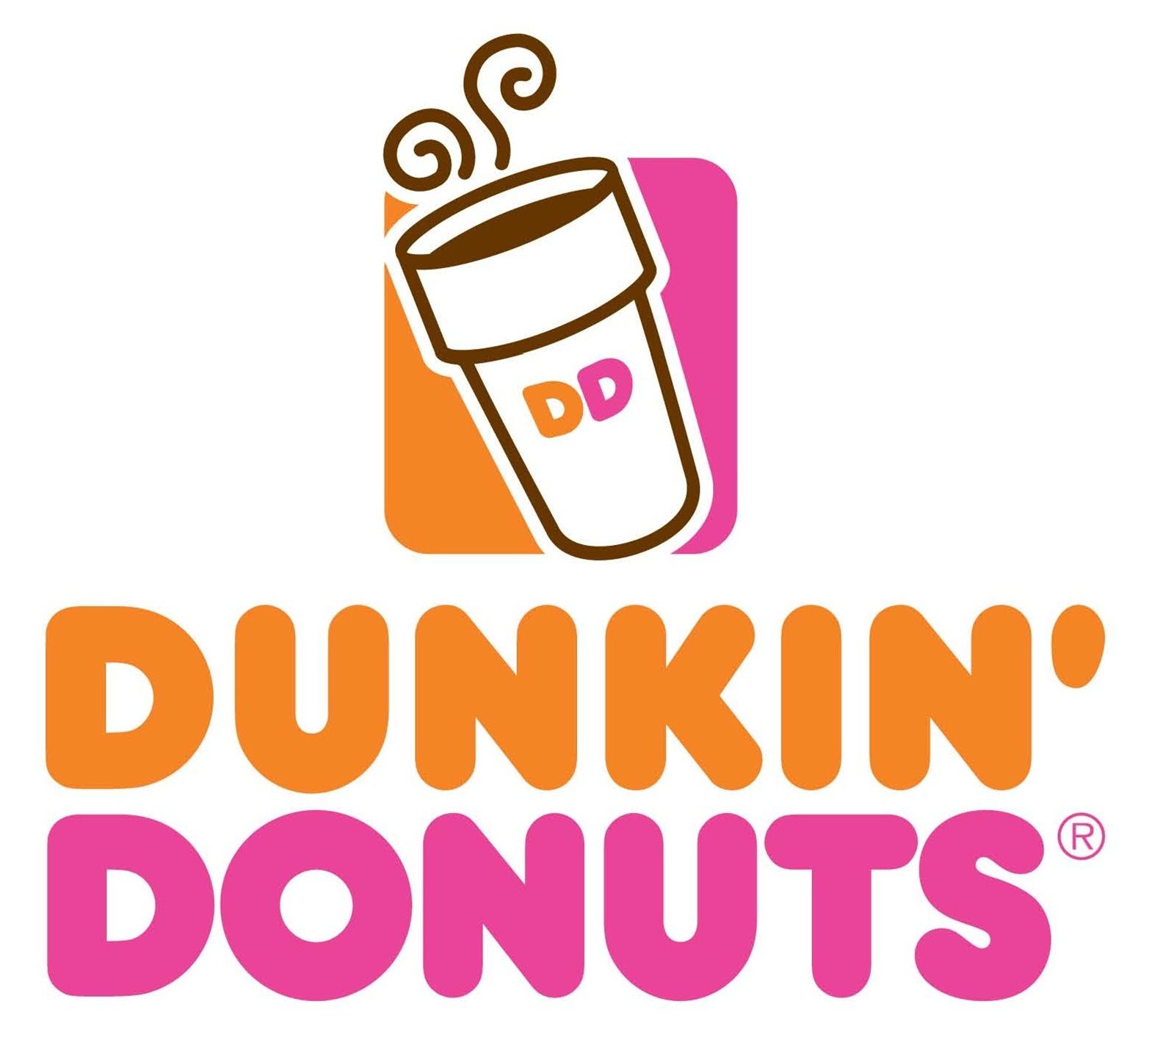



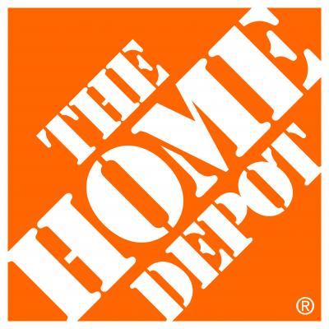
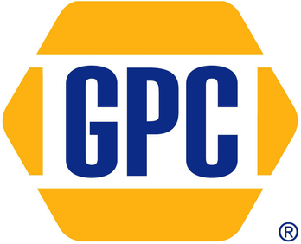

Sharma Vedula
Sr. Principal, Enterprise Architect - Daugherty Business Solutions

Slide 5




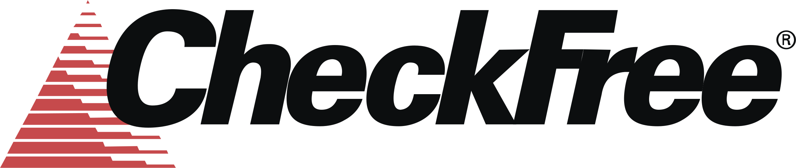


Tony Stuchel
Sr. Principal, Solution Architect - Daugherty Business Solutions

Slide 6


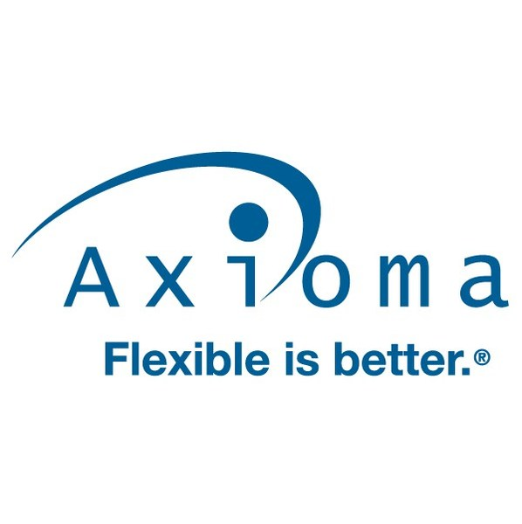



Rob Curry
Sr. Principal, Solution Architect - Daugherty Business Solutions

Slide 7











Kelly Morrison, Ph.D. Computer Engineering
Solution Architect - Daugherty Business Solutions

Slide 8
Let’s begin at the end...

Slide 9

After returning from this workshop...
Hello, Peter, what’s happening.
Listen, if you could sum up that all day DDD workshop for me in two minutes, that would be great.

Slide 10
And, of course...
Oh, and if you could do it without a lot of technical mumbo jumbo, that would be terrific, mmmmkay?

Slide 11

You:
Okayyyyyy…..

Slide 12
Domain-Driven Design, explained for your boss

Slide 13
Domain-Driven Design is an entire development philosophy
Getting domain experts to talk with developers
Creating a conceptual model of a business
Identifying the work that needs to be done
Allocating resources appropriately
Making sure projects are scoped properly
Using specific tactics to implement a design
Implementing layered architecture
Getting along with other teams and services
ANALYSIS
DESIGN
IMPLEMENTATION

Slide 14


Domain-Driven Design is… getting domain experts to talk with developers
Domain Expert
Software Developer

Slide 15



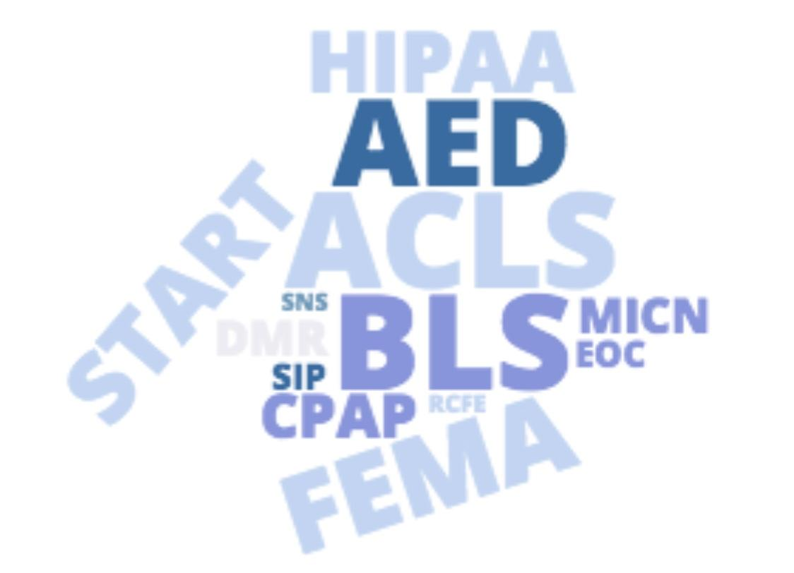
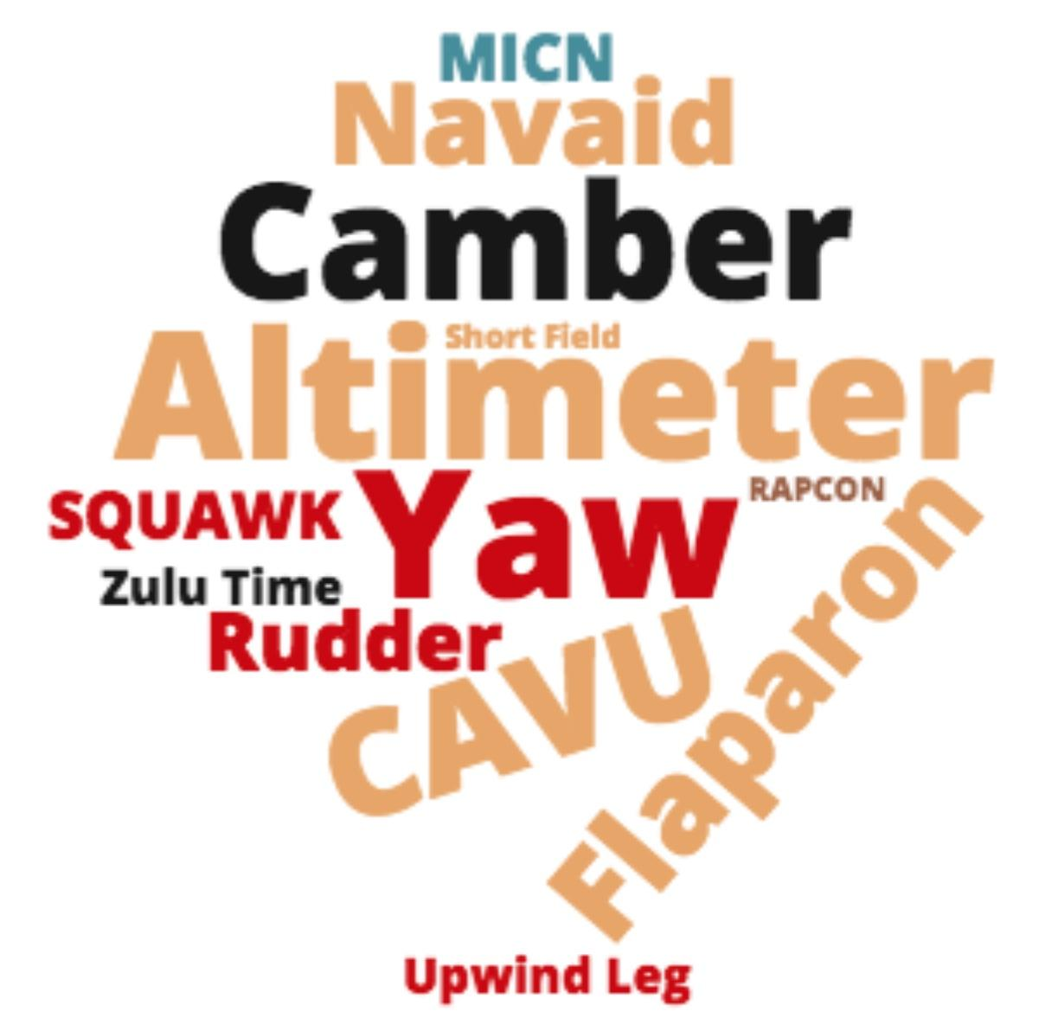
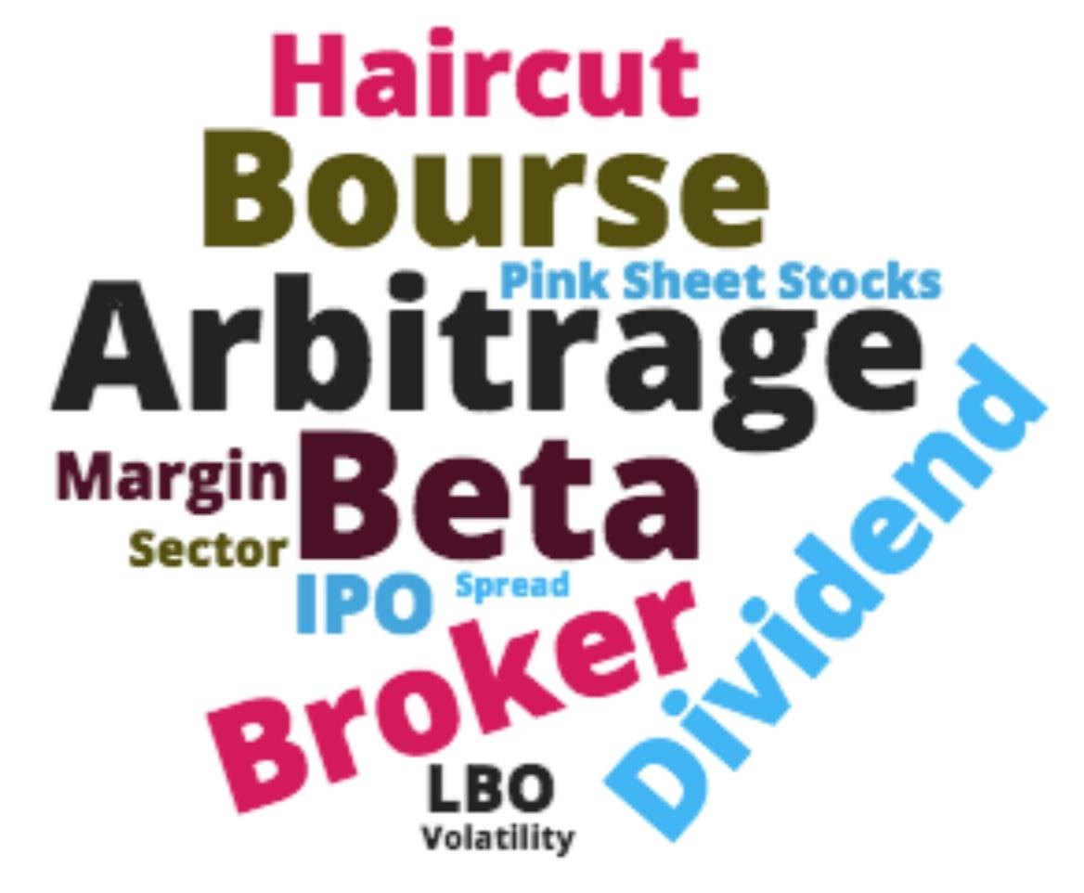
Domain-Driven Design is… creating a conceptual model of a business (domain)

Slide 16

Domain-Driven Design is… identifying the work that needs to be done
“We need to sell our Cosmic Space Modulators online.”
“They’re not built very well, so we should allow returns.”
“I suppose we have to pay our workers, so we need to handle payroll.”

Slide 17






Domain-Driven Design is… allocating resources appropriately
Does it make us money?
Can we buy or lease it?
Do we have to build it anyway?

Slide 18
Domain-Driven Design is… making sure projects are scoped properly
Order entry service
Orders database
Help page

Slide 19
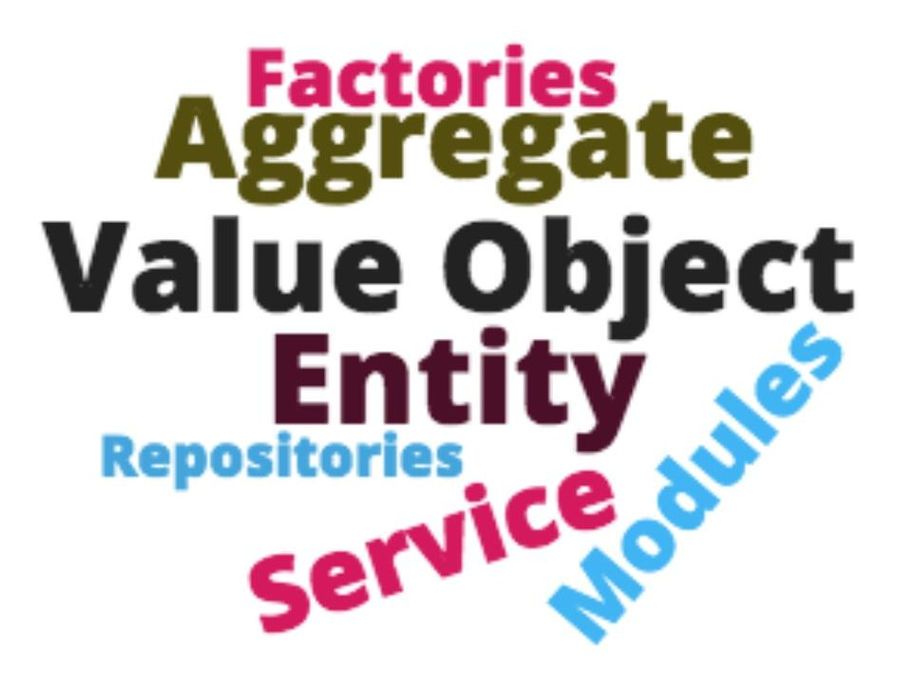

Domain-Driven Design is… using specific tactics to implement a design

Slide 20


Domain-Driven Design is… implementing layered architecture

Slide 21
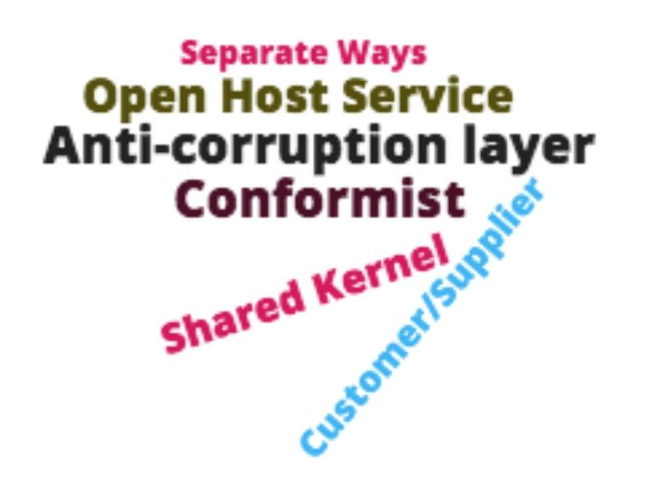

Domain-Driven Design is… getting along with other teams and services

Slide 22
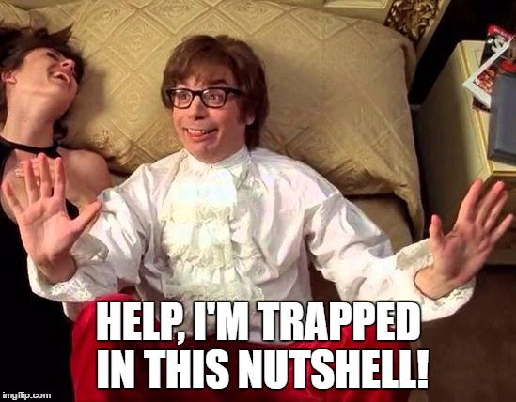
That’s Domain-Driven Design in a nutshell!
Getting domain experts to talk with developers
Creating a conceptual model of a business
Identifying the work that needs to be done
Allocating resources appropriately
Making sure projects are scoped properly
Using specific tactics to implement a design
Implementing layered architecture
Getting along with other teams and services

Slide 23
After your two minute explanation...
Yeah, thanks Peter.
Oh, and don’t forget to turn in your TPS report, okay?

Slide 24
Overview & History

Slide 25
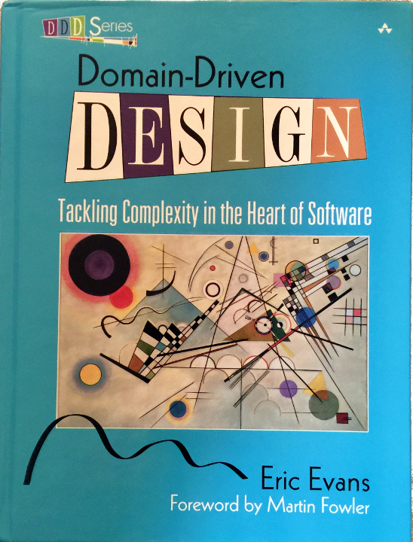

Domain Driven Design is...
… an approach to developing software for complex needs by deeply connecting the implementation to an evolving model of the core business concepts.
It uses a creative collaboration between domain and technical experts to iteratively cut ever closer to the conceptual heart of the problem.
Created by Eric Evans in 2003.
Notes:
DDD focuses on three core principles:
Focus on the core domain and domain logic.
Base complex designs on models of the domain.
Constantly collaborate with domain experts, in order to improve the application model and resolve any emerging domain-related issues.
[Expand on “development philosophy”]
Set of principles and patterns for creating a software design
Basic steps
Understand the domain
Create a ubiquitous language
Build a model of the domain

Slide 26
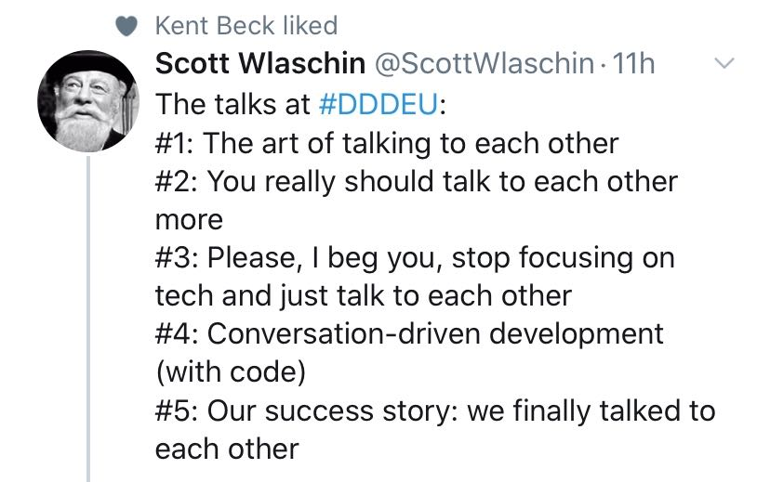
You could almost think of Domain-Driven Design as “conversation-driven design”
Twitter
02/07/2020

Slide 27
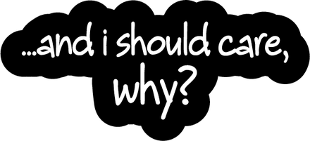
The purpose of Domain-Driven Design is to...
Address the strategic initiatives of the business.
Initiate a creative collaboration between technical and domain experts to iteratively refine a conceptual model that addresses domain problems
Provide principles & patterns to solve difficult problems
Base complex designs on a model of the domain
Meet the real technical demands of the software by utilizing tactical design modeling tools to analyze and develop the executable software deliverables.
Notes:
Strategic initiatives: While this strategic design approach naturally includes technical analysis, its concern is more for the strategic direction of the business. It helps define the best inter-team organizational relationships, and provides early warning systems for recognizing when a given relationship could cause software and even project failure.
Tactical Design: tactical design tools allow developers to produce software that is a correct codification of the domain experts' mental model, is highly testable, is less error prone (a provable statement), performs to SLAs, is scalable, and allows for distributed computing.
We might want to mention Fast Learning Loops that apply and refine understanding of the core domain knowledge.

Slide 28
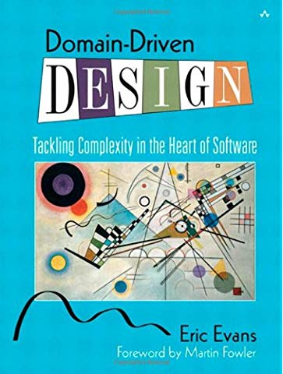
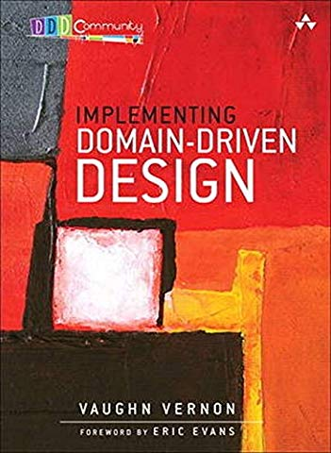
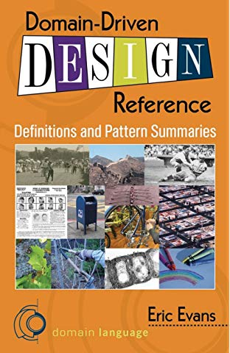
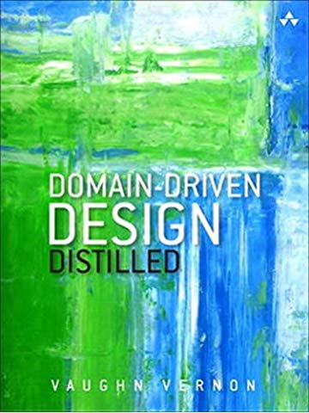






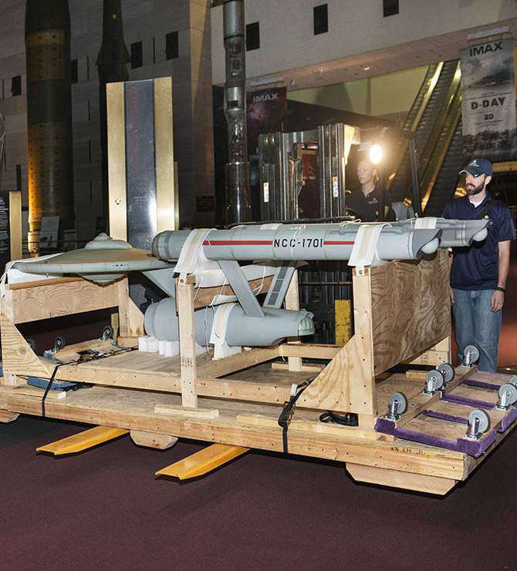

The History of Domain-Driven Design
1967
1982
2004
2009
2013
2014
2016
OOP
Simula-67
OOAD
DDD: Lessons Learned

Slide 29
Section 1
Ubiquitous Language

Slide 30

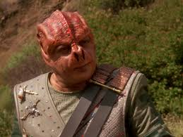
Sometimes, we have trouble understanding others...
Hello! I’m Captain Jean-Luc Picard.
Darmok and Jalad at Tanagra. When the walls fell. Temba, his arms open.

Slide 31

I’m never getting off this planet...

Slide 32
Meanwhile, back on Earth…
… we sometimes have the same problem

Slide 33

Domain Experts vs Software Developers
Singleton
Rubrics
Dependency Injection
LTI Common Cartridge
HATEOAS
Common Core
Erasure Analysis

Slide 34
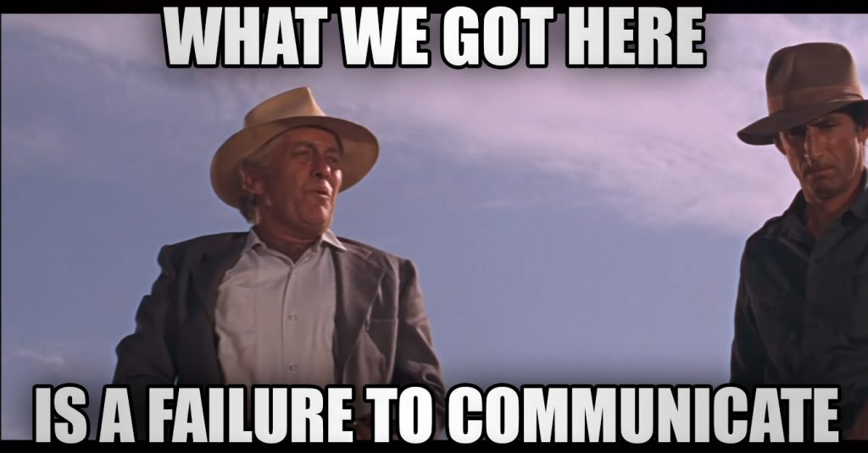

Slide 35


Slide 36
Even people in the same field may use inconsistent terms...

Slide 37

Inconsistent Language
Evaluation
Examination
Test
Pop Quiz
Assessment

Slide 38


Slide 39
We need to define a common, agreed upon language.
A “Ubiquitous Language.”

Slide 40
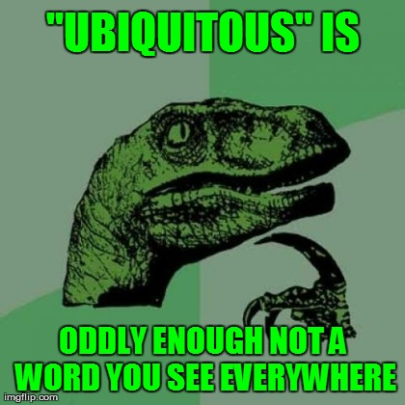
Ubiquitous
adjective
“Present, appearing, or found everywhere.”

Slide 41
Inconsistent Language
Evaluation
Examination
Test
Pop Quiz
Assessment

Slide 42
Common Terms
Test
Test
Test
Test
Test

Slide 43
Common terms aren’t enough
A Test is a scored list of questions and answers.
A Test is a list of questions that I can hand out to my class.
A Test is a scanned image that we have to process.
A Test is a set of questions and answers that I have to grade.

Slide 44
Terms need consistent meaning
A Test is a scored list of questions and answers.
A Test is a scored list of questions and answers.
A Test is a scored list of questions and answers.
A Test is a scored list of questions and answers.

Slide 45
Terms need refactoring, too!
A Scored Test is a scored list of questions and answers.
A Scored Test is a scored list of questions and answers.
A Scored Test is a scored list of questions and answers.
A Scored Test is a scored list of questions and answers.

Slide 46
How do we develop a ubiquitous language?
Spoiler alert: you’re going to do an exercise about this in a few minutes...

Slide 47



Avoid the “telephone game”
Domain
Expert
Business Analyst
Project Manager
Software Developer

Slide 48

That’s too many degrees of separation!

Slide 49

Let’s get everyone talking!

Slide 50
Talk in the language
of the
domain experts

Slide 51
Technical vs Domain Description
Do not use programming terms!!! The use case should be easily understood by the domain expert.
Bad:
“The input manager continually scans the ftp folder for incoming documents. When a document has been sitting there unchanged for two minutes, it gets picked up and placed in a multilevel queue. The database is updated to record the document. When a scan engine is available, the document is sent to it for processing.”
Better:
“A test arrives from a customer. Depending on the SLA we have with the customer, we determine how quickly it needs to be graded. When it’s time for the test to be graded, we get the student answers from the test and retrieve the instructions on how to score each question. We then score each question and calculate an overall score for the test.”
Notes:
Kelly will look at this and make it better

Slide 52
Technical vs Domain Description
Do not use programming terms!!! The use case should be easily understood by the domain expert.
Bad:
“The input manager continually scans the ftp folder for incoming documents. When a document has been sitting there unchanged for two minutes, it gets picked up and placed in a multilevel queue. The database is updated to record the document. When a scan engine is available, the document is sent to it for processing.”
Better:
“A test arrives from a customer. Depending on the SLA we have with the customer, we determine how quickly it needs to be graded. When it’s time for the test to be graded, we get the student answers from the test and retrieve the instructions on how to score each question. We then score each question and calculate an overall score for the test.”
Notes:
Kelly will look at this and make it better

Slide 53
Technical vs Domain Description
Do not use programming terms!!! The use case should be easily understood by the domain expert.
Bad:
“The input manager continually scans the ftp folder for incoming documents. When a document has been sitting there unchanged for two minutes, it gets picked up and placed in a multilevel queue. The database is updated to record the document. When a scan engine is available, the document is sent to it for processing.”
Better:
“A test arrives from a customer. Depending on the SLA we have with the customer, we determine how quickly it needs to be graded. When it’s time for the test to be graded, we get the student answers from the test and retrieve the instructions on how to score each question. We then score each question and calculate an overall score for the test.”
Notes:
Kelly will look at this and make it better

Slide 54
Ubiquitous Language Guidelines
Get domain experts, developers, and other stakeholders using common language in all communication: emails, Slack, presentations, documents...
Stick to terms used in the business domain – no programming terms!
If you find yourself calling things “Cache” or “Manager”, you’re doing it wrong.
Say the terms out loud!
People tend to use different terms, depending on whether they are speaking or writing.
Don’t get too attached to terms – if you find a better one, replace it.

Slide 55
Listen for ambiguous or inconsistent terminology
Domain Expert: “... and then we grade the tests.”
(later)
Domain Expert: “... and that’s how the tests are scored.”
You: “I’ve heard you mention both grading tests and scoring tests. Is there a difference between grading and scoring? If not, which term would you prefer to use?”

Slide 56
Use the same terms as the domain expert
Domain Expert: “... and then we grade the tests.”
You: “I see. And how do you go about scoring the tests?” ← BAD
You: “I see. And how do you go about grading the tests?” ← GOOD

Slide 57
Explore concepts, even if you think you already understand them
Domain Expert: “... and then the teacher picks questions for a test.”
You: “Now, you mentioned the word teacher. Are there different kinds of teachers? Do all of them prepare tests?”
Domain Expert: “Oh, good point. Yes, we have several different kinds of teachers: standard curriculum teachers, special ed teachers, gym teachers, substitute teachers. Only the standard curriculum teachers create tests: when we bring in a substitute teacher, they might give a test, but they don’t create or grade them.”

Slide 58
Be on the lookout for unnamed concepts
Domain Expert: “The school administrator can request information about a teacher, such as how their class is doing compared to other teachers at the same school or in the district and how they’re doing compared to the expected results for that subject and grade level.”
You: “That’s an interesting concept. Do you have a name for that specific collection of information?”
Domain Expert: “Oh, yeah: we call that the Relative Teacher Ranking.”

Slide 59
Don’t use programming terms when talking to the domain expert
Domain Expert: “If a teacher has the same class for more than one year, we’d like to compare the test results for their classes from year to year to see if the teacher is improving or slipping.”
You: “Yeah, I suppose we could keep the test results in the database with an indefinite retention record so that they’re not deleted. Or, we could keep only the results we really need in a table and delete the information we don’t need. And we’ll have to add an index on the year so that we can pull the information quickly.”
Domain Expert: “What’s this about tables and index cards?”

Slide 60

Make the conversation fun! Don’t bore the domain experts!

Slide 61
Useful tools: Word Clouds
Word cloud: an image composed of words where the size of each word indicates its frequency or importance.
Can serve as a starting point for a conversation with domain experts
https://wordart.com/create

Slide 62

It’s time for you to try this!

Slide 63
Some exploratory questions to get you started...
What if a test question is “draw a picture of an elephant”?
How might that be scored? Who would score it?
How does this affect your understanding of the terms “questions” and “answers”?
What other kinds of test questions are there?
What kinds of teachers are there?
What are different ways to score a test?
Could sections of a test be scored in different ways?
How might “extra credit” questions be handled differently?

Slide 64
Exercise 1 - Ubiquitous Language
GOAL
Leverage a word cloud to discover the ubiquitous language of the First Grade project.
https://github.com/DDDDevNexus2020/FirstGrade/blob/master/docs/Section-1-Exercise.md
45 Minutes

Slide 65

Exercise 1 - Ubiquitous Language
15 Minutes

Slide 66
Section 2
Strategic Design

Slide 67
Strategic Design
Domain
Sub-Domain
Ubiquitous Language
Context Map
Bounded Context
Notes:
Also sometimes called strategic modeling. it is a pillar of the DDD along with Tactical Design, which will be covered later. The main objective of Strategic design is to define the Domain, Sub-domain, Bounded contexts, the Ubiquitous Language and the Context Maps together with the entire project team, which are the domain experts and the technical team. To clearly understand what the strategic design is, you need to understand each of these concepts.

Slide 68
Domain

Slide 69
Domain...a sphere of knowledge, influence or activity
Domain, in the realm of software engineering commonly refers to the subject area on which the application is intended to apply.
Domain is also called the “problem space” for which we have to design a solution
Ex. The Home Depot - Supply Chain domain, Pricing Domain, Merchandising Domain, Accounts Receivable domain.
Notes:
Another common term used during software development is the domain layer or domain logic, which may be better known to many developers as the business logic. The business logic of an application refers to the higher-level rules for how business objects interact with one another to create and modify modelled data.

Slide 70
Domain-Driven Design is… allocating resources appropriately
Does it make us money?
(core domain)
Ex. Home Improvement, IT Contracting Services
Do we have to build it?
(supporting domain)
Ex. Delivery, User Management
Can we buy or lease it?
(generic domain)
Ex. Email, payroll
Notes:
Core Domain: The competitive advantage of the business. It defines the business and this is where the money is made
The best way to identify the core domain is to have the application developers work closely with business leaders and business domain experts. Application developers can iteratively define and refine the core domain by asking the business domain experts questions like: What makes the system worth writing? Why not just buy if off the shelf? Why not just outsource it? The answers to these questions and others will help you distill the value of the application and provide focus around the essential core domain. Example: The Home depot’s core domain is “Home Improvement”
Supporting Domain: related to what the business does but not a differentiator. These can be implemented in-house or outsourced. Examples: user account creation, product listings
Generic Domain: not specific to the business and are ideally implemented using off-the-shelf software Examples: reporting systems, email packages, payroll systems

Slide 71
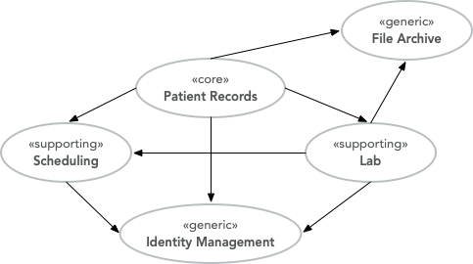
Example: Electronic Medical Records
Notes:
Patient Records: for managing personal information, medical history
Lab: for ordering tests and managing test results. This is related to the business, but not really what the business does.
Scheduling: for scheduling appointments
File Archive: for storing files attached to the patient records (ex.x-rays)
Identity Management: for making sure right people have the right access
https://vaadin.com/learn/tutorials/ddd/strategic_domain_driven_design

Slide 72
Sub-Domain

Slide 73
Sub-Domain belongs to the problem space….
Sub-Domain: a subpart of the Domain
We divide the entire complexity of the Company’s Domain into smaller parts and each of these parts can be considered as a Sub-Domain
Ex. In the case of Supply Chain Domain, it can be broken down into: Delivery Sub-Domain, Order Sub-Domain, Inventory Sub-Domain, etc.
Notes:
Typically, we will have domain experts who will understand the aspects of the business well enough for a specific subdomain.

Slide 74
Bounded Context

Slide 75
A Bounded Context is a Logical Boundary
Bounded context defines tangible boundaries of applicability of some subdomain.
A Bounded Context is a walled-off section of the domain where the Ubiquitous Language is valid
Each Bounded Context has its own Ubiquitous Language
Bounded Contexts belong to the “Solution” space
Notes:
It is an area where a certain subdomain makes sense.
There is not necessarily a one-to-one mapping between bounded contexts and subdomains. Since a bounded context belongs to the solution space and a subdomain to the problem space, you should think about the bounded context as one alternative solution among many possible solutions. Thus a single subdomain can contain multiple bounded contexts. You may also find yourself in a situation where a single bounded context spans multiple subdomains. There is no rule against this, but it is an indication that you may need to rethink your subdomains or context boundaries.

Slide 76
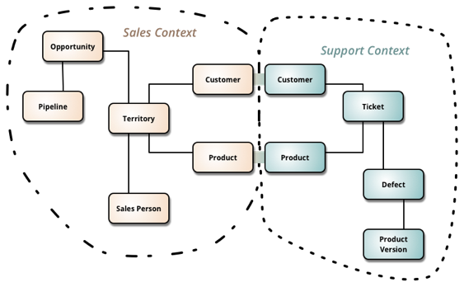
What if we have more than one Bounded Context?

Slide 77
Context Map

Slide 78
Context Map - global view of the application as a whole
Context Mapping is a technique that helps architects and developers manage types of complexities in software development
A Context Map is a way to handle relationships between different bounded contexts
A Context Map is used to show how each Bounded Contexts fits, and the relationships between them.
There are several different types of relationship:
Shared Kernel
Customer/Supplier
Conformist
Anticorruption Layer
Separate Ways
Open Host Service
Notes:
A context map should be simple enough to be understood by the domain expert and the technical team
Don’t show detail of a model in the context map
To communicate with other context maps there are patterns that describe common relationships between bounded contexts
Context Mapping provides a high level view that might help the developers to take strategic decision

Slide 79
Domain-Driven Design is… getting along with other teams and services

Slide 80
Use Case:
Imagine that we’ve been brought into an existing offline retailer as Consultants to create a new online Ecommerce website for the company.
Interface with the company’s existing systems to provide a seamless new channel for sales.
Consume and return data from each of the existing systems in order to make the new channel seamlessly integrate into the current architecture.
Send data to the distribution and financial systems so orders are processed correctly and the company’s accounting liabilities are dealt with.
Notes:
https://culttt.com/2014/11/26/strategies-integrating-bounded-contexts/

Slide 81
Shared Kernel
Shared Kernel
Customer/Supplier
Conformist
Anticorruption Layer
Separate Ways
Open Host Service
Billing Context
Marketing Context
Invoice
Payments
Customer
Promotion
Communication
Notes:
If 2 teams want to collaborate closely and have a lot of commonality in terms of domain logic, the overhead of translating from one bounded context to another might be too much. So, they might decide to share that part of the model, which is known as shared kernel.
This introduces the risk in terms of one team breaking the implementation of the other team, so this requires the 2 teams to align their Ubiquitous languages. Constant communication between the 2 teams is a must for a shared kernel to be successful.
In our Ecommerce example, the Billing Context requires the Customer Model to associate transactions and request payments, whereas the online Marketing context requires the Customer Model to send marketing information to stimulate new purchases and keep the customer informed of new products and offers.

Slide 82
Customer / Supplier
Shared Kernel
Customer/Supplier
Conformist
Anticorruption Layer
Separate Ways
Open Host Service
Finance Context
Analytics Context
INTERFACE
Transactions
Customer
Trends
Recommendation
Supplier/Upstream
Customer/Downstream
Notes:
The contexts are in upstream-downstream relationship and this is formalized such that the upstream team is the supplier and the downstream the customer. They can work independently, but the supplier is expected to take the customer’s needs into account.
The teams should define automated tests which can validate the interface the supplier team provide. This way the supplier team can make changes to their code without the fear of breaking something downstream.
https://vaadin.com/learn/tutorials/ddd/strategic_domain_driven_design
https://inside.getyourguide.com/blog/2019/11/18/tackling-business-complexity-with-strategic-domain-driven-design
An example of the Customer / Supplier relationship from our Ecommerce analogy could be where a separate Analytics context must take data from the Ecommerce application in order to generate customer recommendations and predict new trends. The Analysis application is in a different Bounded Context because it is likely to be written in a different programming language and use very different tools and persistent storage than that of the Ecommerce application. The Analysis application is relying on the Ecommerce application to send data of the transactions, customer profiles and tracking events in order to run the analysis. The two teams should agree upon on the type, format and method of the data and how it should be transferred downstream. If both teams are aligned in increasing the success and profitability of the company as a whole, this relationship is more likely to work.

Slide 83
Conformist
Shared Kernel
Customer/Supplier
Conformist
Anticorruption Layer
Separate Ways
Open Host Service
3rd Party Delivery Context
Order Context
INTERFACE
Delivery
Order
Customer
Supplier/Upstream
Customer/Downstream
Notes:
The contexts are in upstream-downstream relationship, but the supplier does not need to take customer’s needs into account. The customer has to conform to the model of the upstream.
An example of the Conformist relationship in our Ecommerce analogy could be where we rely on a third-party delivery service to send packages to our customers. In order to update our customers on the location of their progress we need to request updates from the third-party delivery service. However, we are only one of thousands of customers of the delivery service, and so they have no motivation to provide the data we require. The delivery service is also free to change their API at any point, potentially breaking our integration. In this situation we are completely at the mercy of the delivery service and so we have to take responsibility for accepting their data and the interface they provide for requesting it. If the interface changes, it is our responsible to conform to those changes and evolve our integration to meet those requirements.

Slide 84
Anticorruption Layer (ACL)
Shared Kernel
Customer/Supplier
Conformist
Anticorruption Layer
Separate Ways
Open Host Service
Offline Customer Loyalty Context
Online Customer Loyalty Context
Loyalty Programs
Customer
ACL
Customer
Loyalty Programs
Notes:
When you are creating a model for a sub-system that communicates with other subsystems, you might have to interface with models developed by other teams and as they are part of a different bounded contexts, they might be expressed using their own ubiquitous language. And this may cause corruption in the model in your bounded context.
Enter, Anti-corruption layer, which is an isolation layer in the middle, which takes care of adapting and translating the model of one bounded context to another.
http://www.abhijainsblog.com/2016/11/anti-corruption-layer-and-shared-kernel.html
https://vaadin.com/learn/tutorials/ddd/strategic_domain_driven_design
https://inside.getyourguide.com/blog/2019/11/18/tackling-business-complexity-with-strategic-domain-driven-design
An example of using an Anti-Corruption Layer in our Ecommerce analogy could be linking an existing customer loyalty scheme from the offline retail system with a customer loyalty scheme for our new online retail system.
When a request is sent or received, it will travel through the Anti-Corruption Layer to be translated into the appropriate form for the receiving application. This means data can flow between the two systems without having to change the existing offline system and without having to conform the new system to the model of the existing system.

Slide 85
Separate Ways
Shared Kernel
Customer/Supplier
Conformist
Anticorruption Layer
Separate Ways
Open Host Service
CSV
New Finance Context
Existing Finance Context
Transactions
Customer
Notes:
This pattern does not perform any integration at all. When the benefit of the integration between two contexts is no longer worth the effort, it is better to cut the contexts loose from each other.
The few services provided by the upstream context that the downstream context actually used are re-implemented inside the downstream context.
What are some possible strategies to protect “your” context in this situation?
https://vaadin.com/learn/tutorials/ddd/strategic_domain_driven_design
This integration pattern is special in that it does not perform any integration at all. Still, it is an important pattern to keep in the toolbox and may end up saving a lot of money and time. When the benefit of the integration between two contexts is no longer worth the effort, it is better to cut the contexts loose from each other and let them evolve independently. The reason for this could be that the systems have simply evolved to a point where they are no longer related. The (few) services provided by the upstream context that the downstream context actually used are re-implemented inside the downstream context.
The apps will not share anything and will have very little to no data exchange, each one of them will function independently from the other apps
They could share the same access layer or middleware layer, but each of them will execute within its own bounded context
Used when integration does not provide many benefits to the system and could make the models complex or add a useless translation layer overhead
An example of Separate Ways in our Ecommerce analogy could be that of reporting financial statistic to the retailer’s existing finance department. The finance department uses an archaic system that would take a long time to integrate with our new ecommerce application. Instead we can simply ensure that financial reports can be exported in the required format. This means the two systems don’t need to be integrated at all and so we lose the overhead of trying to make the integration work.

Slide 86
Open Host Service (OHS)
Shared Kernel
Customer/Supplier
Conformist
Anticorruption Layer
Separate Ways
Open Host Service
Existing Apps
Special Services Context
Inventory Application
Order Fulfilling Application
OHS
No Translation Required
Financial Application
Notes:
The Bounded Context offers special services everybody can use. This will let every team assemble their own integration.
This pattern is different from others in that it does not care about the relationship between contexts and the teams that develop them.
This is useful when an integration with numerous other systems is necessary and when the implementation of these integrations is to laborious.
http://www.informit.com/articles/article.aspx?p=2738465&seqNum=3
https://vaadin.com/learn/tutorials/ddd/strategic_domain_driven_design
An example of using the Open Host strategy in our Ecommerce application could be providing data about the customers and transaction as a series of Services. Many of the existing applications inside the company will likely need to request data from our application in order to fulfil orders or restock products, and so instead of providing layers of translation for each system, we can provide a set of Services to reduce this overhead.

Slide 87
Exercise 2 - Context Mapping
GOAL
To practice identifying bounded contexts and apply appropriate context mapping relationships.
https://github.com/DDDDevNexus2020/FirstGrade/blob/master/docs/Section-2-Exercise.md
45 Minutes

Slide 88
Exercise 2 - Context Mapping
15 Minutes

Slide 89
Section 3
Tactical Patterns

Slide 90
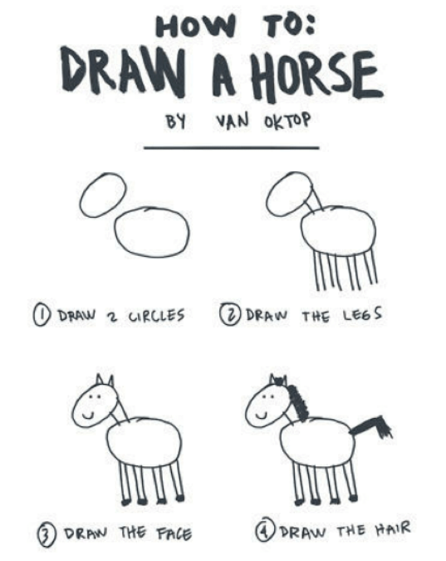
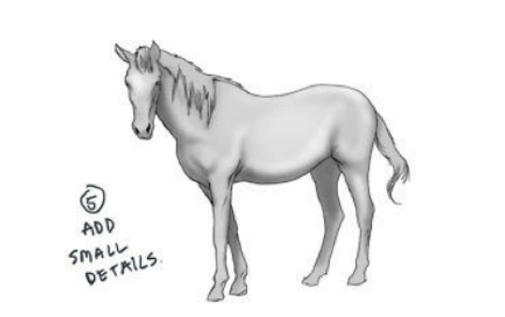

Slide 91
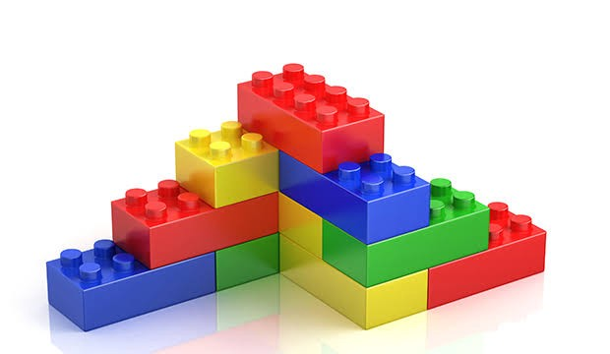
Tactical Patterns
Entities
Services
Factories
Repositories
Value Objects
Modules
Aggregates
Notes:
Where Strategic Patterns talk about how bounded contexts interact, Tactical patterns are more granular patterns that apply within a specific bounded context. This is where the words used in the ubiquitous language become code.

Slide 92
Entities
A “Thing” in the ubiquitous language of a Domain
No public setters
Command-based state-changing methods
Room ID
Building Number
Room Number
Has a Unique Identity
Established by the object’s constructor
System-provided UUID
One or more immutable properties
Room
Room ID
Chair Count
Color
Teacher ID
Has a Life Cycle
Created
Changes State
Deleted/Archived
Usually persisted (database, files, etc.)

Slide 93

Lombok
Pre-compilation code generation using annotations for boilerplate code
Auto-create property accessors
@Getter
@Setter
Auto-create constructors
@AllArgsConstructor
@RequiredArgsConstructor
And many more!
@EqualsAndHashCode
@Builder
… etc
https://projectlombok.org/
Notes:
I want to show some code next, but before I do I’ll need to talk a bit about Lombok, what I feel to be one of the best libraries for Java.

Slide 94
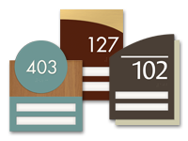
Unique Identity -- By Property
import lombok.AllArgsConstructor;
import lombok.EqualsAndHashCode;
@EqualsAndHashCode
@RequiredArgsConstructor
public class RoomId {
private final int roomNumber;
private final int buildingNumber;
}

Slide 95
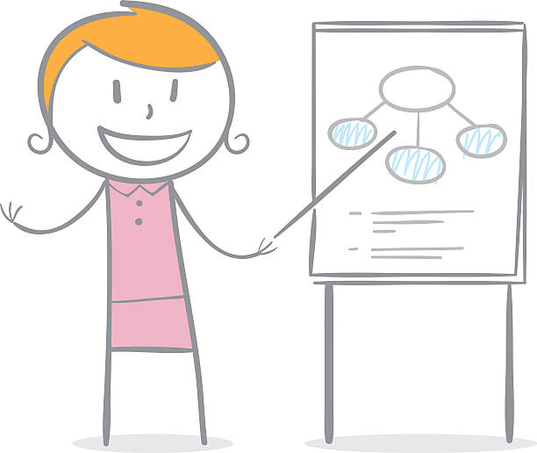
Unique Identity -- By UUID
@Getter
@EqualsAndHashCode
@RequiredArgsConstructor
public class TeacherId {
private final String id;
}
/**
* Spoiler alert! Repository and Factory pattern!
*/
public class TeacherRepository {
public TeacherId nextIdentity() {
return new TeacherId(UUID.randomUUID().toString());
}
}

Slide 96
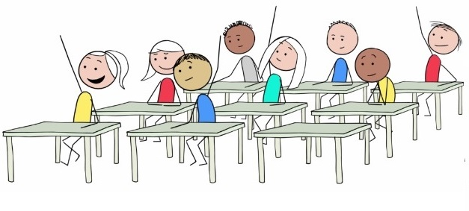
Entities
@Getter
@Setter(AccessLevel.PRIVATE)
@RequiredArgsConstructor
public class Room {
private final RoomId roomId;
private int chairCount;
private String color;
private TeacherId teacherId;
public void configureRoom(int chairCount, String color) {
this.setChairCount(chairCount);
this.setColor(color);
}
public void assignTeacher(TeacherId teacherId) {
this.setTeacherId(teacherId);
}
}

Slide 97
Value Objects
Not really a thing in the ubiquitous language
Describes, measures, or quantifies a thing
A “customer name” describes a person but it isn’t uniquely a person.
Full Name
First Name
Middle Initial
Last Name
Are Immutable
Properties set by constructor
No public setters
Equality based on property values (conceptual whole)
Address
Street Name
City
State
Postal Code
Are Transient
Can serve to seed the creation of an Entity
Can be a copy of property values of an Entity
Web service contracts

Slide 98

Value Object Example
@With
@Getter
@Builder
@EqualsAndHashCode
@AllArgsConstructor(access = AccessLevel.PRIVATE)
public class Address {
private String streetName;
private String city;
private String state;
private String postalCode;
}

Slide 99
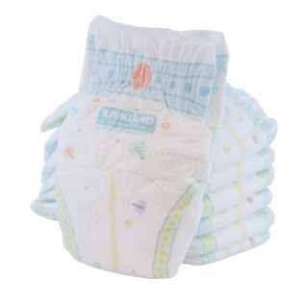
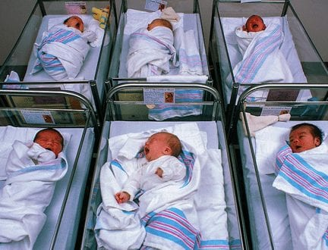
Value Object or Entities
Notes:
Value objects have no identity and are interchangeable. A diaper is a value object: if someone asks you to get a diaper from the closet, they don’t care which one: one is as good as the other, and they’re all alike. On the other hand, if your wife asks you to go to the hospital nursery and get the baby, she’s going to care which one you bring back! Babies are entities: each has its own identity (name, DNA, SSN) and they are NOT interchangeable!

Slide 100
Aggregates
Customer
Id
Customer Name
Address
Favorite Color
A group of objects that function as a single unit
Has an Entity as the root object
May have other Entities and Value Objects that it controls
Managed by the root Entity
Other objects access child object through the root entity
Changes to child objects are made through the root entity
May enforce invariants on its children
Customer Name
First Name
Middle Initial
Last Name
Transacted as a single unit
All or nothing commit/rollback/delete
If child objects can be modified outside of the root entity, then the aggregate should only hold references (entity IDs), and child modifications should be modified via own transactions.
Address
Street Name
City
State
Postal Code

Slide 101
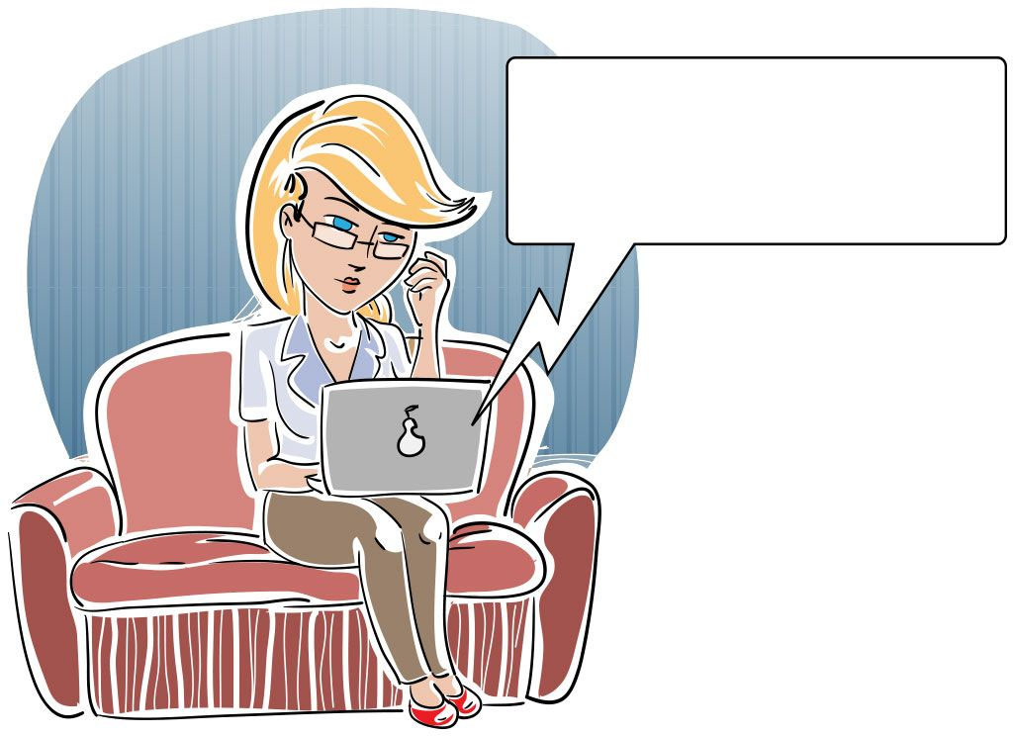
Aggregates
@Getter
@NoArgsConstructor(access = AccessLevel.PRIVATE)
public class Teacher {
private UUID id;
private String name;
private Address homeAddress;
public Teacher(UUID id, String name) {
this.id = id;
this.name = name;
}
public void changeHomeAddress(Address address) {
this.homeAddress = address;
}
}
09:31PM - Kimmy:
MY KAT 8 MY HOMWRK CAN I HAZ AN *A* ANYWAY PLZ ???

Slide 102
Services
A Service:
Should be part of the Ubiquitous Language
Contains operations that don’t seem to fit in an Entity
Often references multiple Entities
Use cases include:
Calculations that require multiple entities
Transformation/Translation that maps one entity or value object to another
Commands that affect more than one entity (warning!)

Slide 103
Service
/**
* Operates on more than one entity of the same type.
*/
public class DemographicService {
public double calculateAverageAge(Collection<Customer> customers) {
// return the average age
}
}
/**
* Operates multiple entities of a different type.
*/
public class AccountTransferService {
public void transferFunds(Account fromAccount, Account toAccount, Money amount) {
// transfer the funds
}
}

Slide 104
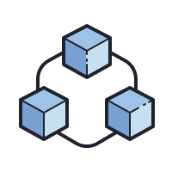
Modules
A Module is used to subdivide a domain
Part of the Ubiquitous Language
Groups related concepts and objects
It should group related concepts and objects
Think of this as a business grouping, not a program grouping
Implemented in Java using packages
Should be loosely coupled with other packages
Should reflect an “aggregate family”
Should not be by component type (entities, value objects, etc.)
There’s no “official” right/wrong here… only guidelines
Focus on domain first

Slide 105
Modules
Domain is most important:
com.company.domain.*
com.company.domain.subdomain1.*
com.company.domain.subdomain2.*
com.company.infrastructure.database.*
com.company.infrastructure.web.*
Then layer:
*.ui.*
*.api.*
*.app.*
*.model.*
*.infrastructure.*
/src/java/com/company/
/domain1
/...
/domain2
/subdomain1
/…
/subdomain2
/ui
/api
/app
/model
/infrastructure
/infrastructure
/database
/web

Slide 106

Factories
Used to create or “rehydrate” an object:
Should be an atomic operation
Useful for creating Aggregates
Patterns for factories:
Abstract Factory
Factory Method
Builder

Slide 107
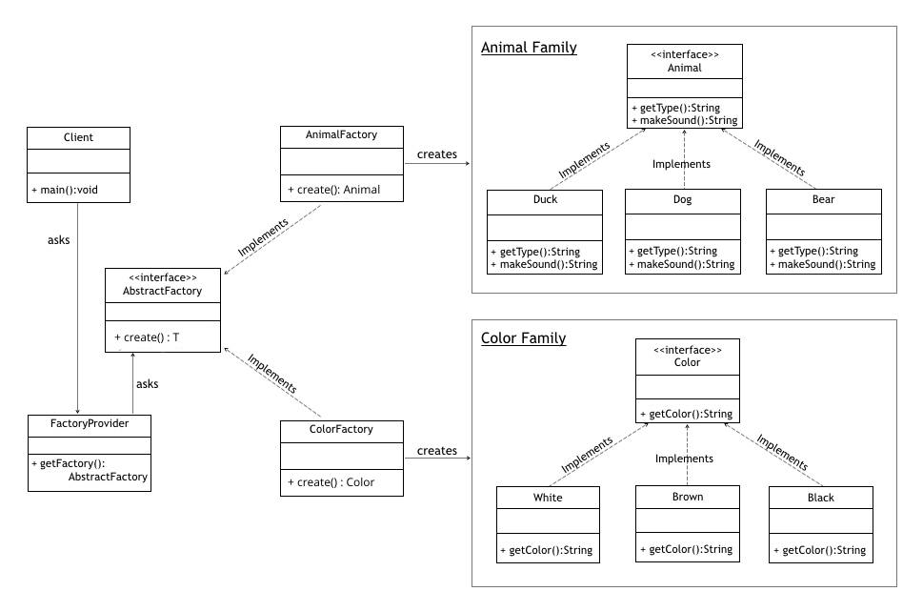
Factories (Abstract Factory)
https://www.baeldung.com/java-abstract-factory-pattern

Slide 108
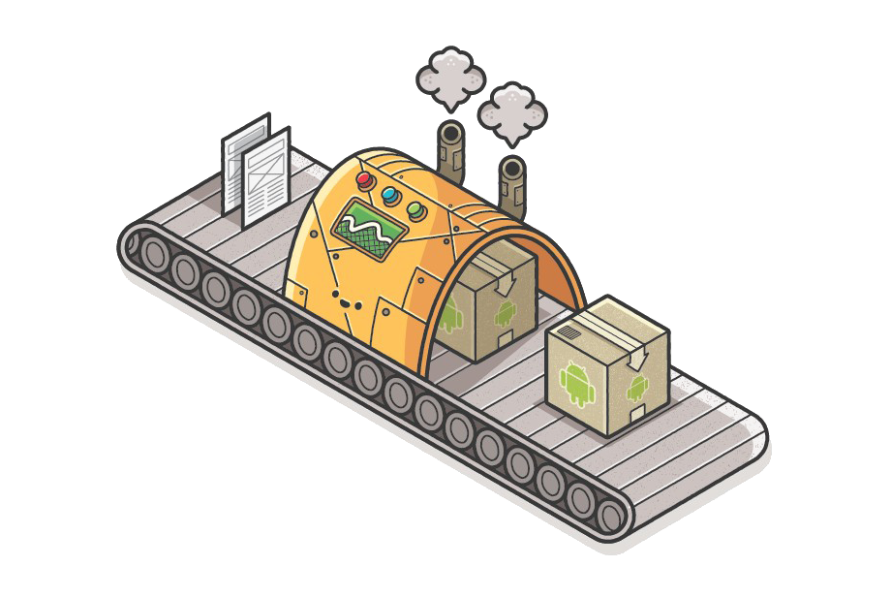
Factories (Factory Method)
@Getter
@Setter(AccessLevel.PRIVATE)
@RequiredArgsConstructor
public class Customer {
private final CustomerId id;
private CustomerName customerName;
private Address address;
public static Customer of(String firstName, String lastName, String city,
String state) {
Customer customer = new Customer(new CustomerId(UUID.randomUUID().toString()));
customer.setCustomerName(new CustomerName(firstName, null, lastName));
customer.setAddress(new Address(null, city, state, null));
return customer;
}
}

Slide 109
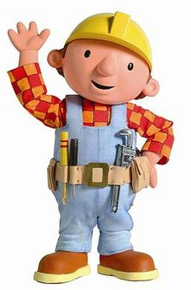
Factories (Builder)
@With
@Getter
@Builder
public class Address {
private final String streetName;
private final String city;
private final String state;
private final String postalCode;
}

Slide 110
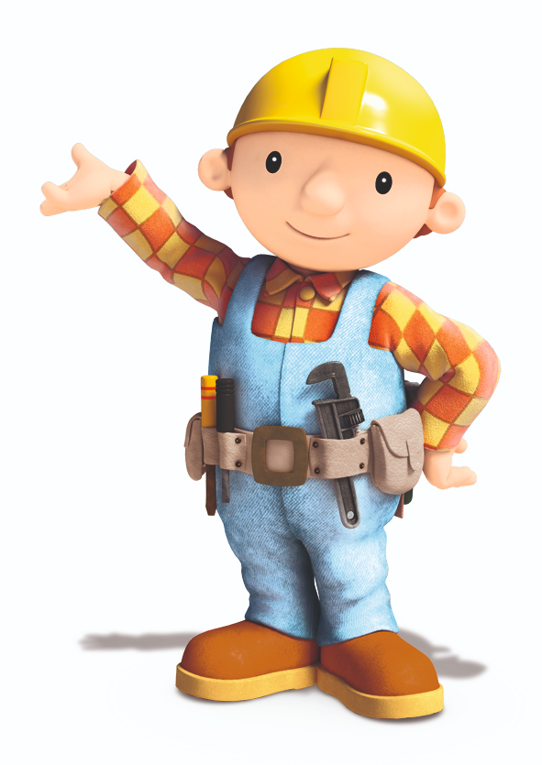
Factories (Builder Part Deux)
@Test
void addressBuilder() {
// Builder
Address address = Address.builder()
.streetName("1600 Pennsylvania Ave")
.city("Washington")
.state("DC")
.postalCode("20006")
.build();
assertEquals("1600 Pennsylvania Ave", address.getStreetName());
// Pure functional
Address correctAddress = address.withStreetName("1600 Pennsylvania Ave NW");
assertEquals("1600 Pennsylvania Ave NW", correctAddress.getStreetName());
assertTrue(address != correctAddress);
}

Slide 111

Repositories
A Repository encapsulates the storage and retrieval of objects
Contains no business logic
May interact with databases
May interact with external web services (Adapters)
Often implemented by ORMs
JPA / Hibernate
Ebean
JDBI
Keep Command Query Responsibility Segregation (CQRS)
Don’t use an ORM to build complex queries
Keep CRUD operations simple and for one Aggregate only

Slide 112
Repositories
@Entity
@Getter
@Builder
public class Teacher {
@Id
@GeneratedValue(generator = "UUID")
@GenericGenerator(name = "UUID", strategy = "org.hibernate.id.UUIDGenerator")
private UUID id;
private String name;
}
@Repository
public interface TeacherRepository extends JpaRepository<Teacher, String> {
Teacher findByName(String name);
}

Slide 113
Exercise 3 - Tactical Design
GOAL
Design and implement the Question aggregate, an entity in the "Content Domain" to which a list of potential Answers is associated.
https://github.com/DDDDevNexus2020/FirstGrade/blob/master/docs/Section-3-Exercise.md
45 Minutes

Slide 114
Exercise 3 - Tactical Design
15 Minutes

Slide 115
Section 4
Layered Architecture

Slide 116
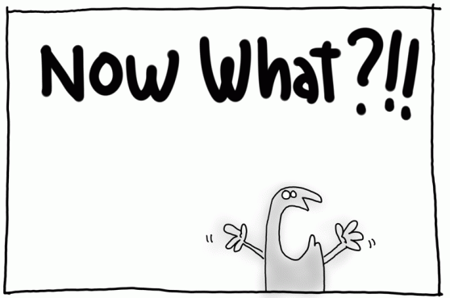
Layered Architecture
You have your newly designed Domain Model: Aggregates, Entities, Services, Subdomains, Value Objects, Context Maps, etc.
Notes:
http://schlichtermath.blogspot.com/2015/10/now-what-next-steps-for-implementing.html
The new Domain Model that you have just designed is not going to live in isolation in your enterprise.
In fact, it is likely to be a small, although well-designed and important, part of your enterprise-wide software landscape.
How do we keep the new Domain Model “clean” as we push it out into that Big Ball of Mud that is all the other software?

Slide 117
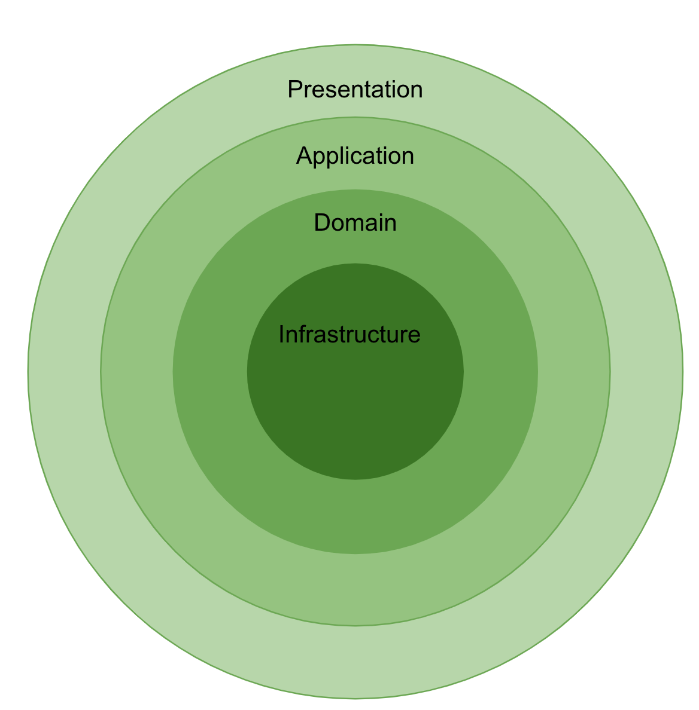
Layered Architecture To The Rescue!
Why Layered Architecture?
Well-known and accepted pattern
Layers of Isolation: each layer is easily and effectively testable
Separation of Concerns: specific roles and responsibilities are delegated to each layer
Leverages interfaces and abstractions
Limits component scope
Achieves cohesion within layers and loose coupling between the domain and other software functions
Business logic is free to follow the “contours” of the Domain Model
Notes:
Commonly referred to as an n-tier architecture. Model View Controller is a one example.
Most of the time, n = 4
Other layers can be stubbed or mocked.
Interfaces and abstractions also facilitate testing.
Reliance on interfaces and abstractions means that the domain remains blissfully ignorant of the implementation details of other parts of the system
Loose coupling between layers may facilitate a distributed, easily-deployable, easily-scalable system.
Layered architecture is not the only way to go. It is, however, the easiest one to understand within the limitations of 2 hours out of an 8 hour session.

Slide 118
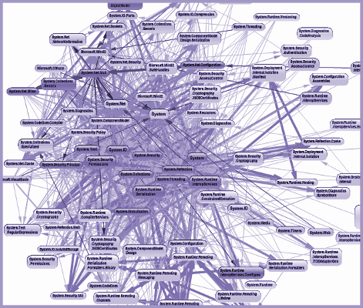
Layered Architecture -- Are You Sure???
If this is so well known, why is the enterprise the Big Ball of Mud that it is?
Well-known does not necessarily mean easy to implement and maintain.
Many enterprise “residents” have not had the benefits of a Domain-Driven Design process.
It can be very tempting to reach over a layer with a seemingly simple use case.
Domain-Driven Design places an emphasis on an ongoing conversation between developers and Domain Experts.
Notes:
http://www.mamuz.de/article/from-big-ball-of-mud-to-emergent-design/0Pw682Kxk
Many systems devolve over time without that feedback loop.
Common signs of this are business logic scattered across all layers, from the GUI to the database and every layer in between.
There are no simple use cases! The GET data request that is straightforward today may required business logic tomorrow.
With DDD, isolation of the business domain is a primary objective right from the start. Isolation in the design serves as the “guide rails” for subsequent development.

Slide 119
Layered Architecture (‘Onion’ View)
Presentation Layer
Accepts user commands.
Displays information to user.
Presentation
Application
Application Layer
Contains anti-corruption translations.
Manages transactions.
Creates/Accesses domain objects.
Domain
Infrastructure
Domain Layer
Aggregates and Value Objects
Business Logic (in Entities and Services)
Infrastructure Layer
Repositories
Frameworks
Adapters
Notes:
This is not GUI, but bounded context end points exposed

Slide 120
Layered Architecture
Presentation Layer
Controllers
Translators
Contracts
Application Layer
Command Objects
Application
Services
Domain Layer
Entities
Value Objects
Domain Services
Infrastructure Layer
Repositories
Adapters
Frameworks
Notes:
Go over Strict (thick arrows) vs. Relaxed (narrow arrows).
This is an alternative view of the layered architecture, with the key DDD elements positioned in their respective layers.
The arrows show here indicate that the layers are not completely closed.
Beware of the architecture sinkhole anti-pattern of using pass throughs at rates higher than about 20% of your code.
For example, it often makes sense to have the application layer manage transaction boundaries.
We will go into more detail in the following slides.

Slide 121
Layered Architecture - Determining What Goes Where
How do we isolate our Domain Model and enforce our Bounded Context?
General Guidelines:
DDD is a special, highly-focused case of Responsibility-Driven Design.
Domain-specific objects--Aggregates, Entities, Modules--should be isolated in a single layer.
Domain layer should be “technology free”.
If using microservices, recognize that microservices are a form of Bounded Context but are generally smaller than the overall domain context.
Notes:
What is good RDD is good DDD, with the responsibility we are focused on being the domain logic/rules.
Microservices perhaps a Subdomain?

Slide 122
Avoid Service Confusion
There are many components in software identified as “services”.
“Service confusion” often leads to business logic being scattered across many layers.
Here are some guidelines for correctly partitioning services into layers:
Application
Service
Domain
Service
Infrastructure
Service
Digests input (JSON, XML).
Reacts to and generates events.
Sends requests to Domain Service for fulfillment.
Listens for confirmation or error response.
Sends events, notifications, and alerts using Infrastructure Service.
Interacts with Entity objects (Teacher, Exam) and applies business logic.
Supplies confirmation of results.
Sends events, notifications, alerts as directed by Application Services.
Retrieves/persists domain data as directed by Application & Domain Services.

Slide 123
Business Rule or Business Process? You Decide!
How do business rules differ from business processes?
Business Rules are statements about what you can and cannot do. They give you the criteria and conditions for making decisions. They define or constrain some aspects of business. They almost always remove some degree of freedom. Examples include:
Retail pricing structure
Milk must be fresh
When discounts and promotions should be applied
Business Process is worked performed. It is generally a transformation or activity that produces output. Examples include:
Printing a customer invoice
Add milk to dry ingredients
Notes:
http://www.brcommunity.com/articles.php?id=b422
https://www.brsolutions.com/tag/business-rules-vs-business-processes/
I am going to use business rule and business logic interchangeably.

Slide 124
Business Rule or Business Process? You Decide!
Teachers shall be notified when a new exam has been created.
Business Rule
Email school administrator when all exams have been graded.
Business Process
Duplicate questions are not allowed on an exam.
Business Rule
Notify test administrator when there are exams ready to be graded.
Business Process
Exam questions must be evaluated and approved by administrator prior to releasing exam for use.
Notes:
http://www.brcommunity.com/articles.php?id=b422
https://www.brsolutions.com/tag/business-rules-vs-business-processes/
I am going to use business rule and business logic interchangeably.

Slide 125
Presentation Layer
The exposed aspect of your application/bounded context
Contains:
REST Controllers
Serializable Contracts (DTO POJOs)
Anti-corruption layer (Translators)
Lightweight contract validation
Depends On:
Application Layer
(Relaxed) to directly access Domain Entities/Value Objects
Concerned With:
Technical details of “web services”
Receiving HTTP request contracts
Translating between Application Layer
Returning response contracts
Returning HTTP status codes
Web service versioning
Example Packages / Classes:
com.fg.staff.teacher.api.TeacherController
com.fg.staff.teacher.api.TeacherTranslator
com.fg.staff.teacher.api.contract.CreateTeacherCmd
com.fg.staff.teacher.api.contract.TeacherData
Does NOT Contain: Business Logic / Rules
Notes:
What does this look like? (Next slide)

Slide 126
Presentation Layer
Client
Incoming Contracts (POJOs)
Outgoing Contracts (POJOs)
Translator
REST Controllers
Translator
Command
(POJO)
Result
(POJO)
Application Layer
Notes:
When discussing Presentation Layer, don’t conflate ‘presentation’ with GUI, which is one particular kind of client.

Slide 127
Application Layer
Coordinates interactions between domain objects
Contains:
Application Services
Command Objects
Domain-specific language
Depends On:
Domain Layer
(Relaxed) to directly access infrastructure for
Repositories and Adapters
Concerned With:
Handling Commands and Queries (CQRS - Command Query Responsibility Separation)
Security/Authorization
Delegating/Coordinating to Domain Objects
Orchestrating Domain model composition
Example Packages / Classes:
com.fg.staff.teacher.app.TeacherService
com.fg.content.question.app.QuestionService
Does NOT Contain: Business Logic / Rules
Notes:
May contain state/progress of task execution.
Knows when to send a message, doesn’t need to know how.

Slide 128
Application Layer
Presentation Layer
Command
(POJOs)
Result
(POJOs)
Application
Service
Application
Service
Application
Service
Domain Objects
Domain Objects
Domain Objects
Value Objects
Value Objects
Value Objects

Slide 129
Domain Layer
Objects that model the domain’s state and behavior
Contains:
Entity Objects
Value Objects
Domain Services
Business Logic / Rules
Depends On:
Infrastructure through Domain Services (not through Entities)
Concerned With:
Validation
Implementing business rules / logic
Changing application state
Example Packages / Classes:
com.fg.staff.teacher.model.Teacher
com.fg.staff.teacher.model.Address
com.fg.ordering.order.model.Order
com.fg.ordering.order.model.TaxCalculationService
Contains: All Business Logic / Rules
Notes:
In order for something to have ‘state’, it must have identity and continuity.
Evans says, “this layer is the heart of business software”

Slide 130
Domain Layer
Application Layer
Value Objects
Domain Object
Domain Object
Domain Services
Domain Services
Adapters
Repositories
Frameworks
Notes:
(Evans) goal: building an implementation that expresses a domain model and uses it to solve important problems
(Evans) minimalism helps keep the business objects readable and expressive
Single Responsibility Principle of Domains: every design decision should be motivated by some insight into the domain

Slide 131
Infrastructure Layer
Responsible for persistence and being a client to external applications
Contains:
Repositories
Adapters
Frameworks
External Contracts (POJOs)
Depends On:
Frameworks
External interfaces
Concerned With:
Persistence of domain state
Interaction with external systems
Domain Event publishing
Example Packages / Classes:
com.fg.staff.teacher.infrastructure.TeacherRepository
com.fg.infrastructure.EventService
com.fg.infrastructure.contract.Event
Does NOT Contain: Business Logic / Rules

Slide 132
Infrastructure Layer
Domain Layer
Adapters
Repositories
Frameworks
Web Endpoints
Databases
Other

Slide 133
Exercise 4 - Layered Architecture
GOAL
Design and implement the presentation and application layers that interface with the Question and Answer entities.
https://github.com/DDDDevNexus2020/FirstGrade/blob/master/docs/Section-4-Exercise.md
45 Minutes

Slide 134
Exercise 4 - Layered Architecture
15 Minutes

Slide 135
Further Information
Read the Eric Evans book. Several times.
“Domain-Driven Design Quickly” by Abel Avram and Floyd Marinescu is a great introduction.
A great list of links to Domain-Driven Design resources may be found at:
https://github.com/heynickc/awesome-ddd
Tool for Context Mapping: Context Mapper
https://docs.microsoft.com/en-us/dotnet/standard/microservices-architecture/microservice-ddd-cqrs-patterns/
Alternative to Layered Architecture:
https://www.kenneth-truyers.net/2013/12/05/introduction-to-domain-driven-design-cqrs-and-event-sourcing/

Slide 136
Eric Evans books

